Slide 1
Human Rights Protection in Norway
Gunnar M. Ekeløve-Slydal
Deputy Secretary General

Slide 2
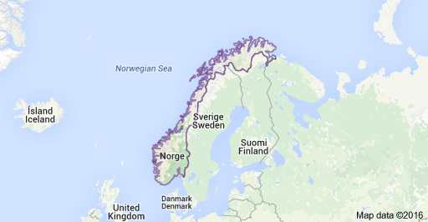
Geography

Slide 3
Basic Facts
Population: 5,2 million (July 2015 Estimate)
Life expectancy: 84/80 (w/m)
Ethnic groups:
  Norwegians: 83.7% (includes Sami, about 60,000),
  Migrants: 16.3 %
  Five National Minorities, with a few thousand persons
323,802 sq km; No. 68 in the world (Romania 83)
Natural resources: petroleum, natural gas, iron ore, copper, lead, zinc, titanium, pyrites, nickel, fish, timber, hydropower

Slide 4
Legislative Framework
Norway’s Constitution has a chapter on human rights
  According to Article 92, authorities are under an obligation to “respect and ensure human rights as they are expressed in this Constitution and in the treaties concerning human rights that are binding for Norway”
1999 Human Rights Act
Several other laws incorporate human rights conventions or transform human rights provisions into Norwegian legal language as provisions of existing laws

Slide 5
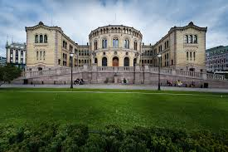
“Stortinget”: The Norwegian Parliament

Slide 6
National Human Rights Institutions
There are several national institutions relevant for human rights in Norway:
  The National Human Rights Institution (NHRI)
    Gáldu – Resource Centre for the Rights of Indigenous Peoples
  The Parliamentary Ombudsman
  The Equality and Anti-discrimination Ombud
  The Ombudsman for Children,
There is in addition, a range of supervisory bodies both at the national and the local level
Dynamic civil society
  Including concerned citizens, establishing campaigns and being active members of organisations

Slide 7
The role of the courts
Norwegian courts play a prominent role in protecting human rights, building on:
  Jurisprudence of the Supreme Court
  Case law of the European Court of Human Rights
However, the Ombud institutions and other complaints or supervisory mechanisms are important for many people:
  The represent low threshold, free of charge and relatively fast ways to have complaints reviewed

Slide 8
The Parliamentary ombudsman
Established by a provision in the Norwegian Constitution of 1814 (§ 75).
The detailed regulation is to be found in the 1962 Act concerning the Storting’s Ombudsman for Public Administration.
  According to § 3, “[t]he task of the Ombudsman is, as the Storting’s representative and in the manner prescribed in this Act and in the Directive to him, to endeavour to ensure that injustice is not committed against the individual citizen by the public administration and help to ensure that human rights are respected.”

Slide 9
Limitations
According to § 4, “[t]he scope of the Ombudsman’s powers embraces the public administration and all persons engaged in its service.”
Excluded from the Ombudsman’s mandate is Parliament decisions, decisions adopted by the Government (“the King in council of the State”), the functions of the Courts of Law, the activities of the Auditor General, matters which fall under the Ombudsman for National Defence and decisions taken by county or municipal political organs
Consequently, even if the Ombudsman’s mandate is “to ensure that human rights are respected”, some parts of the power structure of the Norwegian Society are excluded from it
However, decisions by municipal or county councils “may nevertheless be investigated by the Ombudsman on his own initiative if he considers that regard for the rule of law or other special reasons so indicate.”

Slide 10
Receives about 3000 complaints annually
In 2015, 54 percent of the complaints were dismissed, while 46 were considered on their merits
The Ombudsman criticised decisions by public administration agencies in 146 cases, about 10 % of the cases that were considered on their merits
In many cases, a telephone call from the Ombudsman office is enough in order for the agency to reconsider a decision
  In 2015, this happened in 359 cases or about 25 %

Slide 11

Current Ombudsman, Aage Thor Falkanger

Slide 12
National Preventive Mechanism
On 21 June 2013, the Parliament designated the Parliamentary Ombudsman as the National Preventive Mechanism against Torture and Ill-Treatment (NPM)
An autonomous NPM was established at the Ombudsman’s office during the spring of 2014
The NPM makes regular visits to places of detention, such as prisons, police cells, and psychiatric and child welfare institutions
Submits annual reports on its activities to the Parliament and the UN Subcommittee on Prevention of Torture
The NPM has an advisory committee, including civil society

Slide 13
Human rights cases
In the period 2005-2015, about 70 cases handled by the Ombudsman concerned human rights
According to the Ombudsman, when he investigates whether a citizen has suffered injustice, he also considers whether the citizen's human rights have been violated. “Human rights are in this way an integrated part of the Ombudsman’s ongoing work”
Examples of issues:
  Isolation of prisoners / detainees (solitary confinement);
  freedom of expression of employee’s freedom of expression.

Slide 14
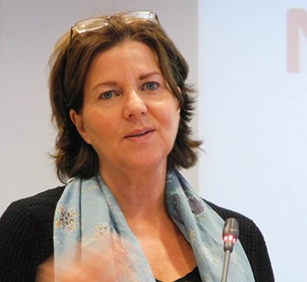
Equality and Anti-Discrimination Ombud Hanne Bjurstrøm

Slide 15
Law enforcer
The Ombud also has an important role as law enforcer of
  the Gender Equality Act,
  the Anti-Discrimination Act,
  the Chapter on equal opportunities in the Working Environment Act,
  the non-discrimination clauses in the housing legislation,
  the Tenancy Act,
  the Housing Association Act, and
  the Residential Building Association Act.
This role of the Ombud includes making decisions on individual complaints. There is no requirement that other avenues of complaining have to be exhausted before complaining to this Ombud.
The Ombud’s statement may be appealed to the Equality and Anti-Discrimination Tribunal.

Slide 16
Ensuring implementation of UN Conventions
Finally, the Ombud is mandated to ensure that
  the UN Convention on the Elimination of Discrimination against Women and
  the UN Convention on the Elimination of Racial Discrimination
... are complied with in law and practice.

Slide 17
Supervisory role
The Ombudsman for Children may not handle individual complaints, but rather has a more supervisory role.
However, all requests from children and young people to the Ombudsman are responded to in order to facilitate guidance and advice.

Slide 18

The Ombud for children is both an office and a person. Anne Lindboe was appointed in 2012 and will function as a Ombud in six years. She is trained as a medical doctor for children, and has also been a researcher. About 20 persons work in her office, producing advice on children’s participation, education, childcare, divorce, harassment problems, and other issues that matters for children. She also has a panel of youth as advisors.

Slide 19
The importance of the Ombud system
Seen in their totality, the Ombud institutions represent important alternatives to the courts. Handling of complaints is free and is normally swifter than taking a case to the court. They may both handle cases regarding decisions and actions.
In particular, the Equality and Anti-Discrimination Ombud have a strong promotional and guidance role regarding anti-discrimination measures. However, the fact that the Government does not always follow up on the Ombud’s statements – e.g when both the Ombud and the Tribunal concluded in 2010 that female police should be permitted to use hijab together with the police uniform – has led to debates about the status and efficiency of the equality and anti-discrimination Ombud and Tribunal.
  The Ombud maintains that anti-discrimination work is a long-term process and that it is to be expected that some statements are met by negative reactions;, there are, however, indications that over time the work of the Ombud will lead to positive results.

Slide 20
The National Institution and the Gáldu
The National Human Rights Institution (NHRI)
  Established in 2001 at the Norwegian Centre for Human Rights at the University of Oslo
  Currently it is being re-established as a separate institution
  Will be presented by its Director, Petter Wille
The Gáldu – Resource Centre for the Rights of Indigenous Peoples
  established by the Government in 2003 in order to increase knowledge and understanding of the rights of Sami and other indigenous populations.
  located in Kautokeino in Finmark County
  Will most likely become part ot eh NHRI

Slide 21
Conclusions
Norway has a well developed system of supervisory and complaints mechanisms which may address specific human rights issues.
Even though, in theory any case on alleged human rights violations may be taken to court, this is costly and may take a long time.
The comprehensiveness, efficiency and quality in terms of human rights of the Ombud protection systems are therefore of crucial importance in order to ensure easy accessible remedies to correct violations for everyone.
There are a few limitations both in terms of the mandates and practice of the different mechanisms. Some vulnerable groups may find it hard to make use of them
There is therefore a debate on how to improve the system, for instance by re-establishing the National Institution for Human Rights and by changes in the role of the Equality Ombud in terms of handling complaints

